Slide 1
Real Time AI Systems

Slide 2
Lecture 1a: Concurrency and Parallelism

Slide 3
Concurrency
Concurrency means handling multiple tasks at once by managing when each task runs (interleaving execution).
Concurrency in AI Use-cases:
Preprocessing large datasets while training
Loading models in the background
Serving multiple inference requests at once
Making simultaneous API calls (e.g., fetching embeddings or documents)
Term | Definition
Concurrency | Multiple tasks progress at the same time (not necessarily simultaneously)
Parallelism | Multiple tasks run at the same time (literally, e.g. on different cores)

Slide 4
Parallelism
Parallelism means performing multiple tasks simultaneously, using multiple processors or cores.
Parallelism in AI Use-cases:
Batch Processing of any ML/DL Model
Tokenization of documents (can be parallelized)
In-house compute intensive work, where CPU/GPU is not in idle
Term | Definition
Concurrency | Multiple tasks progress at the same time (not necessarily simultaneously)
Parallelism | Multiple tasks run at the same time (literally, e.g. on different cores)

Slide 5
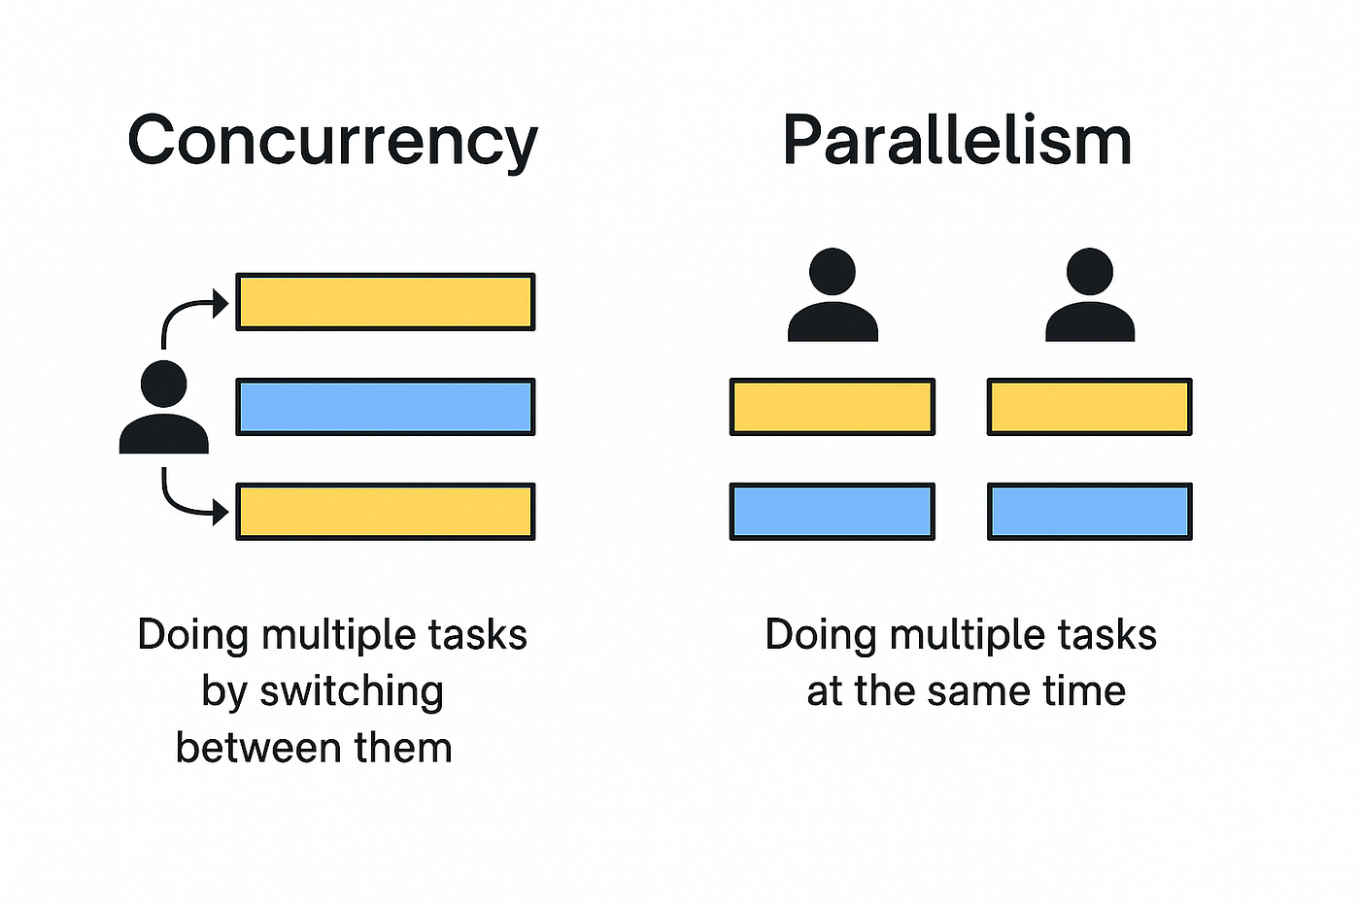
Concurrency v Parallelism

Slide 6
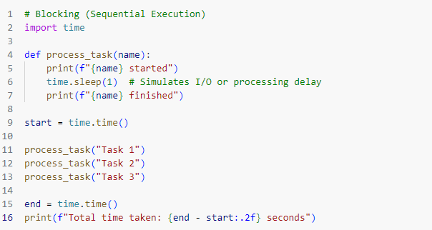
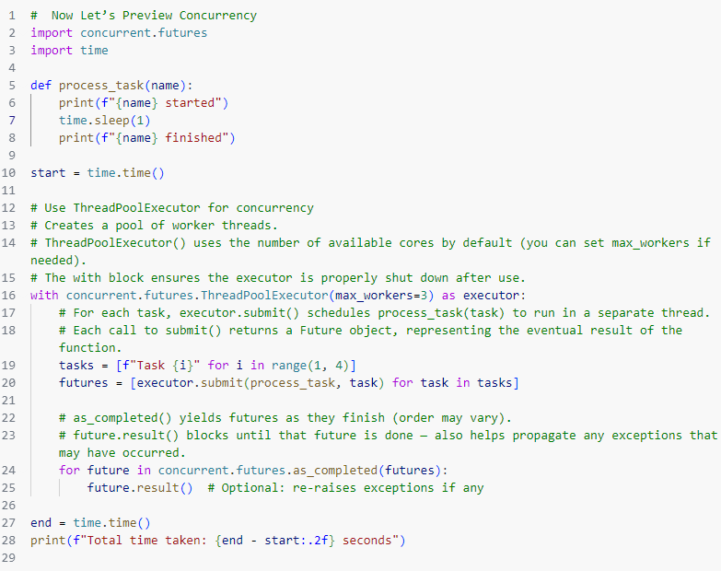
Concurrency

Slide 7
Assignment 1a
What You’ll Do:
Pick any 3 public APIs— maybe to get weather, names, space data, etc.
Pick any 3 simple websites — like a news site, blog, or reference page.
Fetch data from APIs (parse the JSON)
Scrap basic page info (like titles, headings, or paragraphs)
Do it all concurrently using `concurrent.futures.ThreadPoolExecutor`
Output:
Cleanly print API and scraping results
Show how long it took (benchmark the total time)
Bonus (if you want to stretch):
Try a sequential version and compare speed
Handle failures gracefully
Try using the `asyncio` library to handle the concurrency

Slide 8
Lecture 1b: GIL, Multi-Threading, Multi-Processing

Slide 9
GIL - Mutex
A mutex is different from a binary semaphore, which provides a locking mechanism. It stands for Mutual Exclusion Object. Mutex is mainly used to provide mutual exclusion to a specific portion of the code so that the process can execute and work with a particular section of the code at a particular time. A mutex enforces strict ownership.
The Global Interpreter Lock (GIL) is a mutex that protects access to Python objects, preventing multiple native threads from executing Python bytecode at the same time in CPython (the standard Python interpreter).
Exists to:
To make memory management (esp. garbage collection) thread-safe without complex locking
Simpler, safer model for most developers

Slide 10
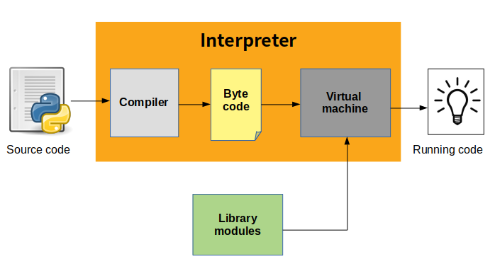
GIL - Mutex

Slide 11
GIL - Mutex
Why GIL is a Limitation:
- Even if you create multiple threads, only one runs Python code at a time
- GIL blocks true parallelism for CPU-bound tasks in CPython
- GIL does not block:
- Native C extensions (NumPy, TensorFlow)
- I/O operations (like file read, HTTP requests)

Slide 12
Threads vs Processes
Thread:
- A thread is a basic unit of execution within a process.
- Shared Memory
Process:
- A process is an independent unit of execution with its own memory space.
- Separate Memory and Resources.

Slide 13
Multi-Threading
What is Multi-threading:
Multithreading allows a Python program to spawn multiple threads (lightweight, shared-memory tasks) that run seemingly at the same time — especially useful for I/O-bound tasks.
Great for tasks like:
- Reading/writing files in parallel
- Downloading from APIs
- Handling simultaneous user requests
Not good for CPU-bound work in CPython due to the GIL
Python 3.9+ switched mainly to `concurrent.futures` for ThreadPoolExecutor and ProcessPoolExectuor

Slide 14
Multi-Processing
What is Multi-processing:
Multiprocessing enables a Python program to run multiple processes in parallel, each with its own memory space and interpreter — bypassing the GIL.
Great for tasks like:
- Batched Data preprocessing
- Heavy numerical calculations
- Batch model inference
Not Ideal for tasks which can be performed sequentially, and I/O related operations

Slide 15
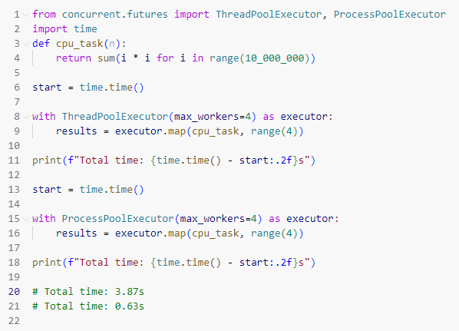
Multi-Threading v Multi-Processing

Slide 16
IPC
Inter-process Communication:
Inter-Process Communication (IPC) in Python refers to the mechanisms that allow different processes to exchange data and synchronize their execution. This is essential when building complex applications where multiple parts need to run concurrently and interact.
Various Methods to do this using multi-processing library:
- Pipes (Two-way communication)
- Queues (Message Passing – Consumer Producer Pattern)
- Signals (Basic Event Notification)

Slide 17
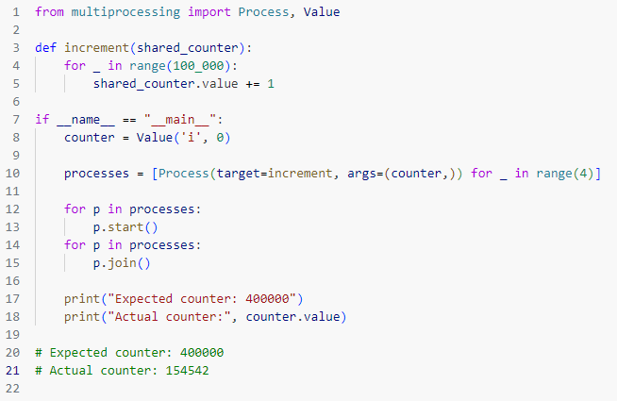
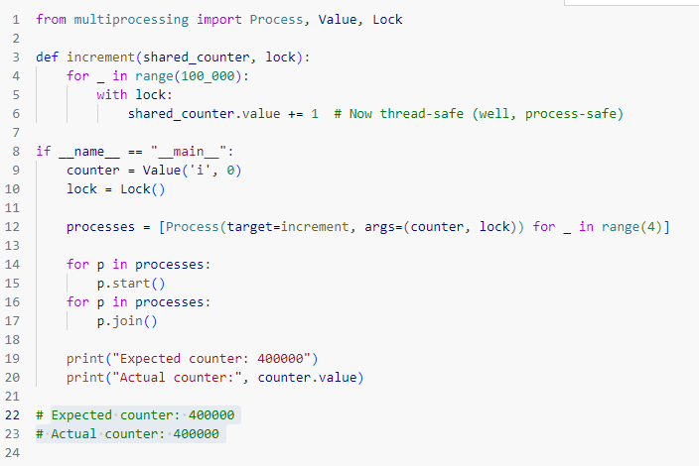
Race Conditions
Race Conditions:
A race condition is a failure case where the behavior of the program is dependent upon the order of execution by two or more threads/processes. This means that the behavior of the program will not be predictable, possibly changing each time it is run.

Slide 18
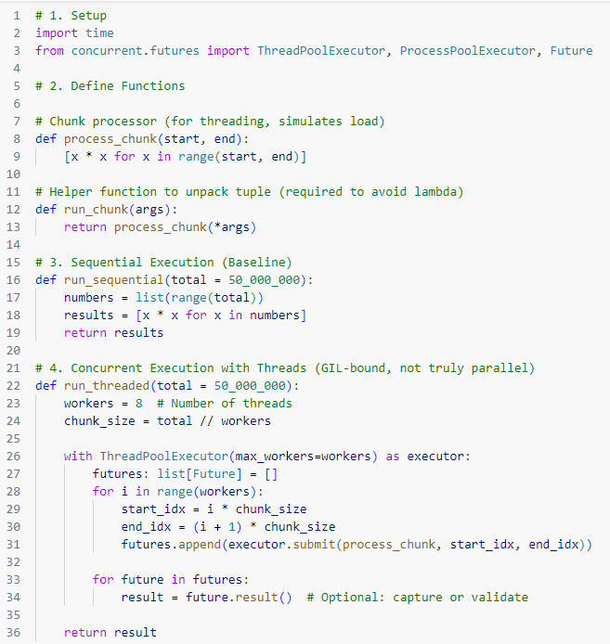
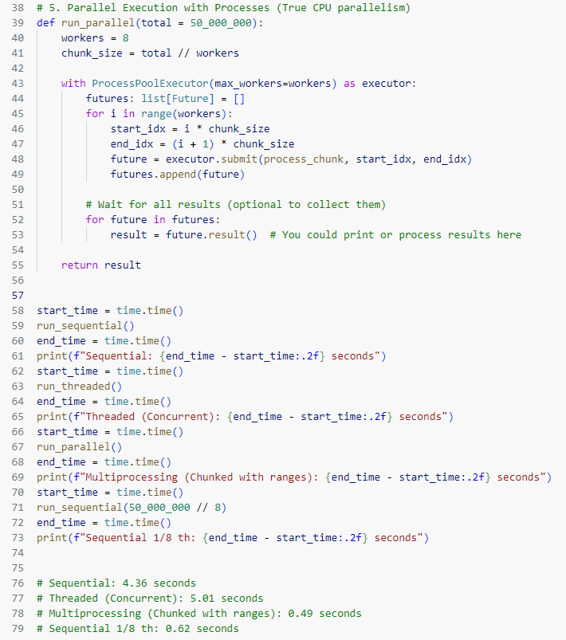
Multi-Threading v Multi-Processing

Slide 19

Assignment 1b
What You’ll Do:
Download/Install Ollama (LLM Inference Platform)
Download Qwen 3 4B LLM model in Ollama
Serve with Concurrency disabled and enabled
Benchmark concurrency of the system in both cases
This is a guided assignment, aimed to give exposure to the state of the art concurrent system
Use same prompt and temperature = 0 to make sure only time difference is coming from concurrency

